Slide 1
Firemen’s Insurance & Inspection Fund Training
Welcome!!

Slide 2
Purpose of Training Session
The purpose for the 1% Regional Training is to:
Educate all SCSFA member departments
Educate individuals who have the oversight of their department's Firemen’s Insurance & Inspection Fund account
Assure compliance to the State Law and guidelines

Slide 3
Goal of Training Session
The goal for the 1% Regional Training is to:
Communicate the same information to all departments
Reduce number of follow up audits performed on a yearly basis

Slide 4
Goal of Training Session

Slide 5
Purpose & Goal of Training Session
The training will provide detailed information about the following:
History
Derivation
Eligibility to Receive Funds
Guidelines
Procedures for Completing all Forms
Audit Findings
How to Perform Proper Reconciliations
Segregation of Duties
Proper Accounting Policies and Procedures

Slide 6
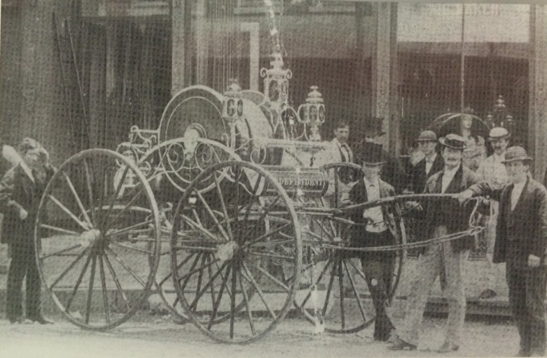
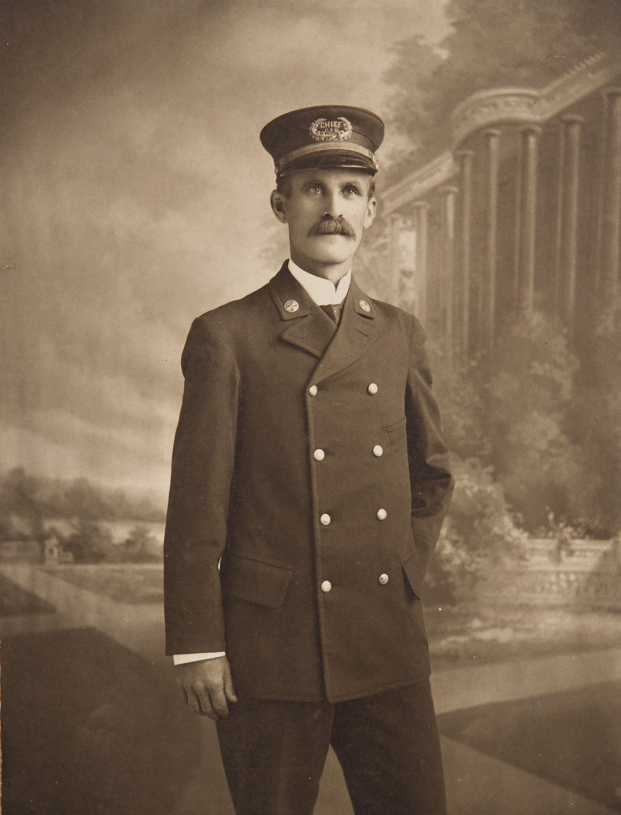
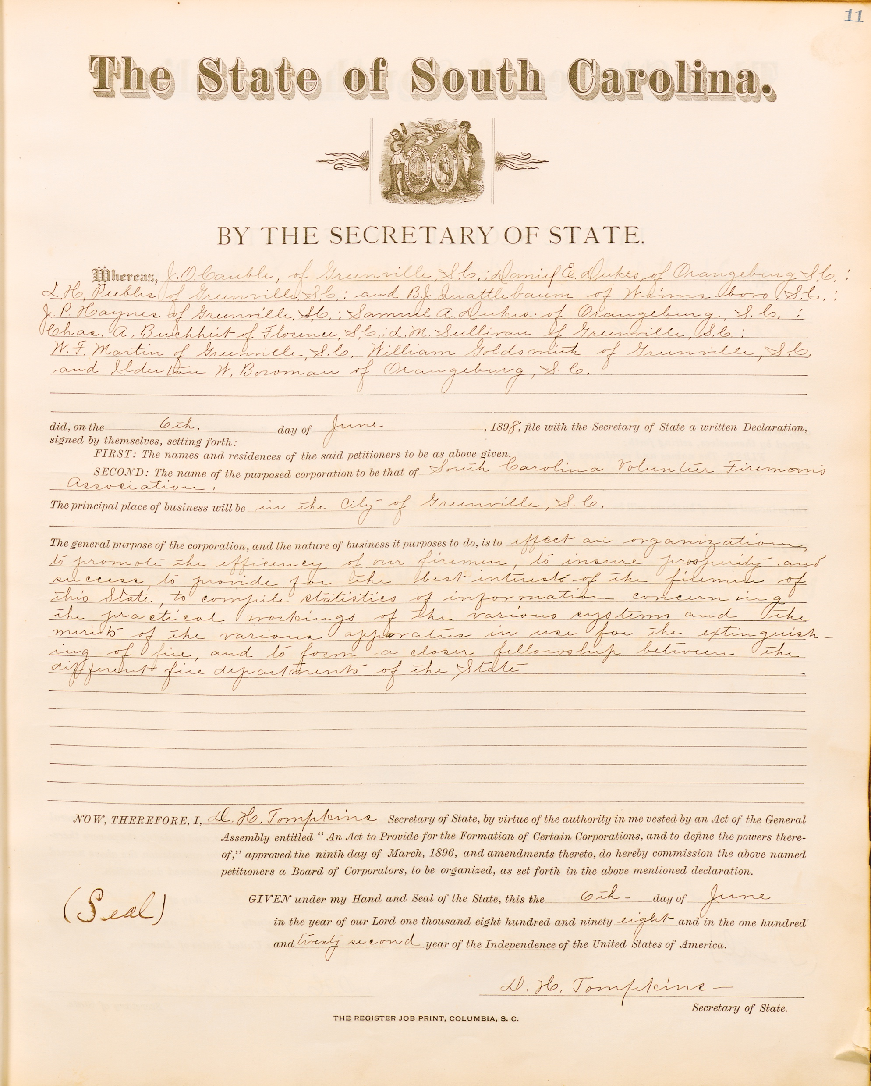
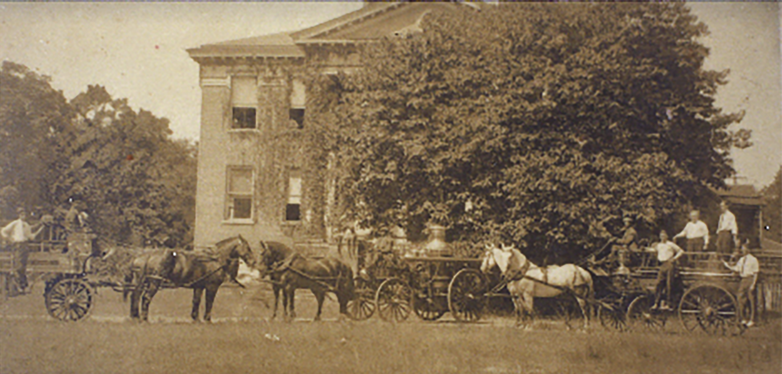
History of the Firemen’s Insurance & Inspection Fund

Slide 7
History of the Firemen’s Insurance & Inspection Fund
The SCSFA was organized on May 30, 1905. The first important bill fostered by the SCSFA was the “Firemen’s Fund Bill”. It was discussed in 1905 and proposed to become a law in 1907. The initial proposed law was to create a fund for firemen derived from a 2% tax on fire insurance premiums paid by property holders in towns and cities to foreign insurance companies.
The insurance companies waged a battle to contest the act in becoming a law. The initial proposed law was declared unconstitutional. Even though the original proposed act was amended from a 2% tax to 1%, with their efforts, President Behrens, his legislative committee and counsel of the SCSFA fought gallantly for the act to become law. Through their efforts, the law for the Firemen’s Insurance & Inspection Fund was finally passed through legislature on March 10, 1910.

Slide 8
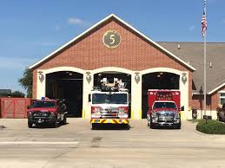
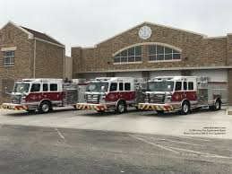
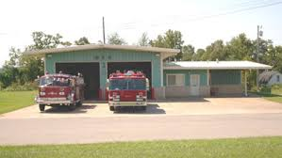
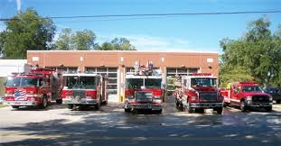
Derivation for the Firemen’s Insurance & Inspection Fund
The Firemen’s Insurance & Inspection Fund is a public fund derived from taxation. Its source is an annual tax assessment levied on the fire insurance premiums paid by property owners to insurance companies who do business in South Carolina.

Slide 9
Derivation for the Firemen’s Insurance & Inspection Fund
Section 38-7-70
Fire insurance companies report insurance premiums by county to the state by March 31st for the previous December year end
Section 23-9-410
State Treasurer sends appropriate amount of funds to each County treasurer
Section 23-9-420
County treasurer must distribute funds within 30 days of receipt to each designated department
Each designated department will receive an amount of the fees computed on the basis of the assessed value of improvements to real estate within the service areas of the fire department, (with the exception of churches, schools and government buildings) and and all monies must be administered by the trustees under the regulations adopted by them.
Section 23-9-430
County treasurers will send 5% of funds received to the Association

Slide 10
Eligibility to Receive Firemen’s Insurance & Inspection Fund
Fire Departments to be eligible to receive a distribution of 1% Funds must do the following for the SCSFA:
Be a member in good standing
Comply with State Law to be an Organized FD:
Have apparatus and equipment valued at least $10,000 or more
Have a minimum of (10) career or volunteer firefighters
Appoint and maintain a Local Board of Trustees for 1% Fund

Slide 11
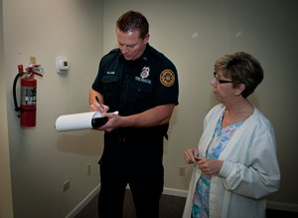
Eligibility to Receive Firemen’s Insurance & Inspection Fund
Fire Departments to be eligible to receive a distribution of 1% Funds must do the following for the State Fire Marshal:
Adopt a building and inspection code
Appoint a Fire Inspector
Perform inspections
File Quarterly reports of the inspections by the 1st of April, July, October & January
File Equipment Certificate by October 31st

Slide 12
Guidelines of Firemen’s Insurance & Inspection Fund
The SCSFA is statutorily empowered to have fiduciary responsibility over the 1% Fund.
Remember the money your department receives, is tax payers money!!
The Chief is ultimately responsible for the overall operation of the fire department however, the 1% Fund is shared equally by ALL members of the fire department.
All items purchased using the 1% Fund are the property of the Fire Department. The Chief has the discretion for ALL items to be returned upon a member’s separation from the department.

Slide 13
Guidelines of Firemen’s Insurance & Inspection Fund
Obtaining approval for all requests:
All expenditures which exceed $100, must be submitted prior to disbursing the funds (Section 23-9-450)
51% of members listed on department’s SCSFA roster must approve the request (Section 23-9-460)
All members of Local Board of Trustees must sign request
Requests must be adhere to the three categories:
Retirement & Insurance
Training & Education
Recruitment & Retention

Slide 14
Guidelines of Firemen’s Insurance & Inspection Fund
Important facts to remember:
None of the funds are permissible to be distributed in cash and/or gifts to individuals (Section 23-9-460)
Requests must be for the collective benefit and enjoyment of the entire department (Section 23-9-460)
No funds can be expended in any manner for any purpose for which the governing body is responsible to provide (Section 23-9-460)

Slide 15
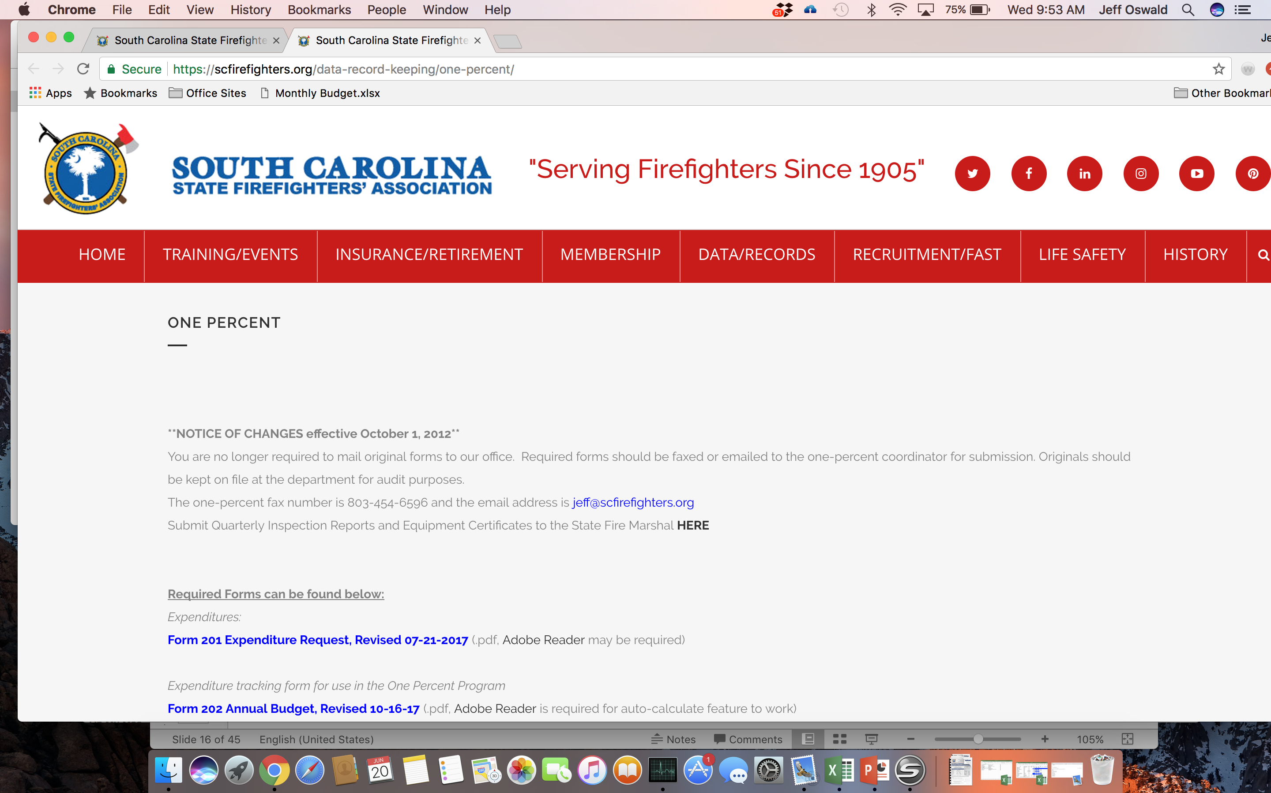
Procedures for Completing All Firemen’s Insurance & Inspection Fund Forms
Where to find the current versions of SCSFA 1% Forms:
Select DATA/RECORDS tab then click 1% INFORMATION
All current forms can be found on the 1% INFORMATION page
When submitting forms for approval, use the current version of forms found on the SCSFA website www.scfirefighters.org

Slide 16
Procedures for Completing All Firemen’s Insurance & Inspection Fund Forms
Form 206 as it appears at the “New” level before any data is entered

Slide 17
Procedures for Completing All Firemen’s Insurance & Inspection Fund Forms
Form 206 after data has been entered at FD level. At this point, the form is ready for FD approval. The form can be denied if any mistakes are found during the review for approval. If mistakes are found, deny the form, correct the issue(s), re-submit and then approve at FD level.

Slide 18
Procedures for Completing All Firemen’s Insurance & Inspection Fund Forms
Form 206 after data has been entered, submitted and approved at FD level. At this point, an email is sent to the SCSFA notifying the form is ready to be reviewed for approval.

Slide 19
Procedures for Completing All Firemen’s Insurance & Inspection Fund Forms
Form 206 denied by SCSFA. An issue with the submitted data was found. The reason for denial is noted on the form. At this point, an email is sent to the FD notifying the form has been denied. FD must correct the mistake(s), re-submit and approve at FD level and then re-submit to the SCSFA for approval.

Slide 20
Procedures for Completing All Firemen’s Insurance & Inspection Fund Forms
Form 206 approved at SCSFA level. At this point, an email is sent to the FD notifying the form has been approved.

Slide 21
Procedures for Completing All Firemen’s Insurance & Inspection Fund Forms
Form 207 approved at SCSFA level. The steps for submitting Form 206 applies to submitting Form 207. The Chief of the Department MUST approve Form 207. At this point, an email is sent to the FD notifying the form has been approved.

Slide 22
GREAT 1% STEWARDSHIP SC FIREFIGHTERS ASSOCIATION TRAINING

Slide 24
GREAT 1% STEWARDSHIP
NOTE!!!
Everything we are going to talk about today is on the Association website under 1%. Therefore we encourage anyone who has any responsibility for 1% funds to visit and review that section of the website. Whenever there is a change in personnel responsibility for all or part of the 1% funds please make sure they visit the website.
Keeping up with the 1% information on the website will answer a lot of questions and help you avoid having to put out fires!

Slide 25
SCSFA Grade Policy-1% funds
A -requested records were completed and available, records were in very good condition, and if any findings were noted, they were minor in nature
B -requested records were completed and available, records were in good condition, and few findings were noted, which were generally minor in nature
C -requested records were not all completed and available, records were in mediocre condition, and there were several findings and/or some of the findings were more serious in nature. A follow-up audit will be performed in the following year and if another grade of “C” or worse is received the department will no longer be considered a member in good standing upon a vote of the SCSFA Executive Committee.

Slide 26
SCSFA Grade Policy-1% funds
D -requested records were generally not completed and available, existing records were not in good condition, and findings were serious in nature. A follow-up audit will be performed in the following year and if another grade of “C” or worse is received the department will no longer be considered a member in good standing upon a vote of the SCSFA Executive Committee.
F -requested records not completed and few if any were available, any existing records were in poor condition, and findings were serious in nature. A department that receives a grade of “F” is considered a member not in good standing upon a vote of the SCSFA Executive Committee.

Slide 27
1% Audit Process
Click Mouse Reveal Next Phase
Selection of departments to audit
GF-second and third visits from the prior year
SCSFA 1% Staff selects primarily based on noncompliance
Phase 1
Letters and requests sent to departments
SCSFA 1% Staff informs them
GF sends list of information needed
Phase 2
GF Audit fieldwork
On-site visit (review findings at end)
Report drafted
Work reviewed by manager and partner-grade assigned by GF
Phase 3
SCFA review
GF and SCSFA review each report, workpapers and grade together
Report drafts are sent to departments
Audit results are presented to SCSFA Executive Committee
Phase 4

Slide 28
Past Findings
See the SCSFA website for details of last three years of findings. What follows are some highlights and more common findings.
The Department was unable to provide a copy of the Forms 202, 205, 206, or 207 which were submitted to the Association or the submitted forms were not properly prepared or submitted within the Association’s required deadlines. (37)
We recommend that someone independent of the check signer reconcile the bank statement to the check register on a monthly basis and that someone independent of the preparer review the bank reconciliation on a monthly basis in order to ensure proper segregation of duties. The preparer and reviewer should sign and date the reconciliation as evidence of the timely preparation and independent review. (29)

Slide 29
Past Findings
Supporting documentation (such as invoices or receipts) was not available for all disbursements tested. (16)
The Department did not obtain required approvals for disbursements made during the year. While the disbursements were properly supported by invoices and represented allowable expenditures in accordance with the Association’s guidelines, we recommend the Department obtain proper approvals through the completion of an Annual Budget (Form 202) or Expenditure Approval Form (Form 201) prior to disbursing funds. (16)
The cost per attendee for a holiday dinner or drill night dinner exceeded the respective $30 and $10 limits established by the Association. We recommend the Department closely monitor the cost of meals when approving disbursements in order to ensure the Department adheres to the Association’s guidelines. Additionally, the Department should maintain a detailed list of attendees for all such dinners to support the expenditures incurred. (14)

Slide 30
Past Findings
The Treasurer or Local Board of Trustees for the 1% funds was not selected in accordance with the Association’s guidelines or state law. (10)
We strongly recommend that two signatures be required on all 1% fund checks. (9)
Other general comments include:
Not using the funds timely and not saving up for a major purchase
Overspending what was approved
Maintaining an accurate and complete detail of activity (strongly encourage software)
No cash, gift cards, other gifts or charitable contributions
No commingling of 1% funds with operating funds; all 1% activity should come into and out of only the 1% bank account

Slide 31
Bank Reconciliations
Extremely important procedure to complete timely and to ensure it is reviewed by someone who is not involved in the cash receipts and cash disbursements.
If someone knows what they are doing they can commit fraud and hide it in the bank reconciliation, especially at smaller entities such as fire departments.

Slide 32
Bank Reconciliation Process
Obtain the bank statement and the ledger for the cash account as of the end of the month.
Determine which deposits and disbursements have cleared and not cleared the bank for the month.
Start with the bank balance, add the deposits in transit that are on your ledger but not on your bank statement, and subtract your checks that are in your ledger but not in your bank.
Subtract interest earned that is on your bank statement but not on your ledger and add bank fees and charges on your statement, but not on your ledger.
Investigate any differences that still exist after items 1-4 above.

Slide 33
Bank Reconciliation Process
Let’s look at an example:
Obtain the bank statement and the ledger for the cash account as of the end of the month.
Determine which deposits and disbursements have cleared and not cleared the bank for the month.
Start with the bank balance, add the deposits in transit that are on your ledger but not on your bank statement, and subtract your checks that are in your ledger but not in your bank.
Subtract interest earned that is on your bank statement but not on your ledger and add bank fees and charges on your statement, but not on your ledger.
Investigate any differences that still exist after items 1-4 above.

Slide 34
Bank Reconciliation Process

Slide 35
Bank Reconciliation Process

Slide 36
Bank Reconciliation Process

Slide 37
Bank Reconciliation Process

Slide 38
Your Policies and Procedures
Written policies and procedures are always important, no matter how small or big of an organization you are.
People come and go, but if you have good written procedures, some one else can step in to replace the person that left much more quickly than if there were no written policies and procedures.
They also help protect you if they have been properly designed and they are operating as designed.
A general rule of thumb is to always have two people involved in everything. Two people involved in receipting, preparing and reviewing bank reconciliations, two people signing checks, etc.
The goal is to segregate duties to minimize the risk of fraud.

Slide 39
The Risk of Fraud/The Fraud Triangle
Three things have to happen for fraud to occur, but only one is in the control of the department-OPPORTUNITY.
In order to minimize the risk of fraud you must minimize the opportunity anyone has to commit fraud. This is why policies and procedures are so important.
So how would you commit fraud with the 1% funds?
Need
Opportunity
Rationalization

Slide 40
Your Policies and Procedures
So here are some very important 1% policies and procedures:
General:
The department should maintain a separate bank account for Firemen’s Insurance and Inspection Funds (“1% funds”). No other funds should be intermingled in the 1% funds account (including revenues generated from donations, drink machines, etc.).
All activity related to the 1% funds account (receipts and withdrawals) should be recorded in a separate general ledger account.
The 1% funds general ledger account should be reconciled to the bank statement on a monthly basis by an individual independent of the check signers. All unidentified reconciling items should be investigated. The reconciliation should then be reviewed and approved by someone independent of the preparer. Both the preparer and reviewer should sign and date the reconciliation. Bank statements and reconciliations should be retained for future reference.
The department should complete all required forms and submit those forms to the Association in a timely manner and in accordance with the Association’s deadlines (including forms 202 – Annual Budget, 205 – Local Board of Trustees (when applicable), 206 – Annual Accounting, and 207 – Compliance Self-Audit). Please note that forms 206 and 207 are ONLY available for online submittal now. The department should maintain copies of the approved forms.

Slide 41
Your Policies and Procedures
So here are some very important 1% policies and procedures:
Cash Receipts:
When 1% funds are received, the Treasurer should record the receipt in the general ledger. Someone independent of the Treasurer should deposit the check in the 1% funds bank account, and a copy of the deposit slip should be retained.
If other monies are received which relate to 1% funds, supporting documentation should be maintained for all receipts to ensure that you can show 100% of the receipts were deposited into the bank account and recorded on the ledger.

Slide 42
Your Policies and Procedures
So here are some very important 1% policies and procedures:
Expenditures:
An Annual Budget Form (202) should be prepared and approved by a majority of the firemen and submitted to the Association for approval or individual expenditures can be approved using the Expenditure Request Form (201).
All expenditures should be reviewed by the Treasurer prior to approval to verify the expenditures are allowable expenditures in accordance with the Association’s guidelines and included in the approved budget. Expenditures in excess of the approved budget should be approved by a majority of the firemen using the Expenditure Request Form (201) and submitted to the Association for final approval prior to disbursement.
All expenditures should be supported by appropriate documentation such as detail invoices or receipts prior to payment.

Slide 43
Your Policies and Procedures
So here are some very important 1% policies and procedures:
Expenditures:
After the Treasurer has reviewed and approved the expenditures, a check should be issued from the 1% funds account.
All checks should be signed by two authorized parties.
A copy of the check should be retained along with the supporting documentation for the expenditure.
No cash withdrawals or checks written to cash should be issued from the 1% funds.
The department should not issue checks to individuals for reimbursement of expenditures incurred; rather, checks should be issued directly to the third party vendor.
For meals, including Christmas parties, documentation should include the number of attendees to ensure you stay below the maximum dollars per meal per person.

Slide 44
Conclusion and Reminders
We are here to help. Our goal is to help you be in compliance with state law and Association regulations, and use those 1% resources as effectively and efficiently as you can.
The primary reason for this training is to help you so that GF does not have to make a second visit to your department because your department was not doing what they should have been doing.
This is not hard, but it does require some time and commitment on a consistent basis. If you are not sure, ASK. The SCSFA 1% Staff is here for you and they will call us if they need help in answering your questions.

