Slide 1
Welcome to the
SC State Firefighters’ Association’s
First Responders’ Assistance & Support Team
Behavioral Health Awareness

Slide 2
Discussion Points of Today’s
Presentation
Firefighter Life Safety Initiative Number 13
Introduction of the “Reaching Out” Program and the First Responders’ Assistance & Support Team
Discussion of the Stressors in the Lives of First Responders

Slide 3
Firefighter Life Safety Initiative Number 13
Firefighters and their families must have access to counseling and psychological support.
Notes:
3

Slide 4
Helping Our Own A Program Dedicated to the Emotional Health and Well-Being of our First Responders and their Families
“Reaching Out”
Presented in Cooperation with the South Carolina State Firefighters’ Association, the South Carolina Fire Academy, the National Fallen Firefighters Foundation and the South Carolina Department of Mental Health.
First Responder’s Assistance & Support Team
F.A.S.T.
(800) 277-2732

Slide 5
“Reaching Out - Helping our Own”
S.C. State Firefighters’ Association
Overall Administration of the Program
Coordination of Insurance Benefits
First Responders’ Assistance & Support Team (F.A.S.T.)
Contact Number: (800) 277-2732
South Carolina Fire Academy
Coordination of Training Components
Awareness Training
Stress & Psychological First Aid
Peer Team Training

Slide 6
“Reaching Out - Helping our Own”
National Fallen Firefighters Foundation
Development of the Training Curriculum through coordination with our Fire Academy
SC Department of Mental Health
Provide and train therapists to deliver clinical services
Provide MHC locations for clinical support of the program

Slide 7
First Responders’ Assistance & Support Team
F.A.S.T.
Dedicated to the Emotional Health and Well-Being of
our First Responders and their Families
The First Responders’ Assistance and Support Team is comprised of Emergency Service personnel from all over the State of South Carolina. It is our mission to be able to provide peer support to our brothers and sisters and to assist them in receiving appropriate clinical behavioral health care in their time of need.

Slide 8
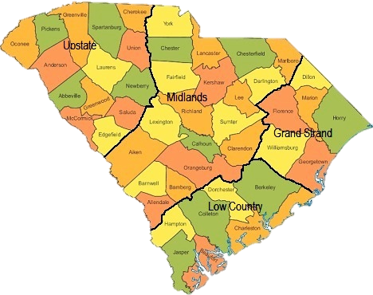
S.C. F.A.S.T. Regions
Patti Graham
Statewide Team Coordinator

Slide 9
Questions?

Slide 10
A Behavioral Health Awareness Program
Stress
in the Life of Emergency Services

Slide 11
A Behavioral Health Awareness Program
Special thanks to
Christopher B. Wells, M.Ed.
Trauma Initiative Coordinator
South Carolina Department of Mental Health
Clinician/Peer Trainer
for the Lowcountry Firefighter Support Team
for his contributions to the development of this program.

Slide 12
Stress Continuum Model
READY (Green) | REACTING (Yellow) | INJURED (Orange) | ILL (Red)
DEFINITION Optimal functioning Adaptive growth Wellness FEATURES At one’s best Well-trained and prepared In control Physically, mentally and spiritually fit Mission-focused Motivated Calm and steady Having fun Behaving ethically | DEFINITION Mild and transient distress or impairment Always goes away Low risk CAUSES Any stressor FEATURES Feeling irritable, anxious or down Loss of motivation Loss of focus Difficulty sleeping Muscle tension or other physical changes Not having fun | DEFINITION More severe and persistent distress or impairment Leaves a scar Higher risk CAUSES Life threat Loss Moral injury Wear and tear FEATURES Loss of control Panic, rage or depression No longer feeling like normal self Excessive guilt, shame or blame | DEFINITION Clinical mental disorder Unhealed stress injury causing life impairment TYPES PTSD Depression Anxiety Substance abuse FEATURES Symptoms persist and worsen over time Severe distress or social or occupational impairment
From “Stress First Aid for Firefighters and EMS Personnel” by the National Fallen Firefighters Foundation

Slide 13
Four Causes of Stress Injury
Intense or Prolonged Stress
Life Threat
Loss
Inner Conflict
Wear & Tear
A traumatic injury
Due to an experience of death-provoking terror, horror or helplessness
A grief injury
Due to the loss of cherished people, things or parts of oneself
A moral injury
Due to behaviors or the witnessing of behaviors that violate moral values
A fatigue injury
Due to the accumulation of stress from all sources over time without sufficient rest and recovery
From “Stress First Aid for Firefighters and EMS Personnel” by the National Fallen Firefighters Foundation
Notes:
Four Causes of Stress Injury
In firefighting and Emergency Medical Services work, trauma is not the only harmful exposure. Stress injuries can arise from four possible mechanisms or causes:
Life Threat—due to traumatic life-threatening or other situations that provoke terror, horror or helplessness. This type of injury can include experiencing a near-miss or close call.
Loss—grief due to the loss of close comrades, leaders, family members or other cared-for individuals.
Inner Conflict—a “beliefs” injury due to conflict between one's moral/ethical beliefs and current experiences. Inner conflict stress injuries can include acting outside of internal, self-imposed morals or values, an inability to prevent harm to others or somehow contributing to or not preventing harm to a fellow firefighter or EMT.
Wear and Tear—the result of fatigue and accumulation of prolonged stress, including from non-operational sources, without sufficient sleep, rest and restoration.

Slide 14
Types of Stress
Cumulative:
Off duty Stress
On duty Stress
Potentially Traumatic Events (PTEs)

Slide 15
Off Duty Cumulative Stress
Family and relationship issues
Finances
Health issues
Change
Loss
No time for relaxation
Adverse effects of attempts to cope

Slide 16
On Duty Cumulative Stress
Departmental Issues:
Multiple and difficult incidents
Personnel conflicts
Overtime or long hours
Policies are not followed
On Scene Issues:
Pandemonium / Chaos
Equipment failure
Family member’s reactions to loss:
“Death defying scream”

Slide 17
Common Effects Stress on Your Body
Sleep problems
Headaches
Muscle tension and pain
Chest pain
Fatigue
Stomach upset
Changes in sex drive
Stress Symptoms: Effects on body and behavior.- The Mayo Clinic

Slide 18
Common Effects of Stress on Your Mood
Anxiety
Restlessness
Lack of Motivation or focus
Feeling overwhelmed
Irritability or anger
Sadness or depression
Stress Symptoms: Effects on body and behavior.- The Mayo Clinic

Slide 19
Common Effects of Stress on Your Behavior
Overeating or undereating
Angry outbursts
Drug or alcohol abuse
Tobacco use
Social withdrawal
Exercising less often
Stress Symptoms: Effects on body and behavior.- The Mayo Clinic

Slide 20
Potentially Traumatic Events

Slide 21
Potentially Traumatic Events (PTEs)
Differences from Civilians
We are expected to have higher tolerance
Those potentially more impacted when not on scene
The Big Four:
Critical incident involving a child
Mass casualty event
Injury or death of another First Responder
Threat of injury or death to yourself

Slide 22
Impact of PTEs
Sleep difficulties
Images of traumatic events (flashbacks)
Reliving traumatic events
Avoiding reminders of traumatic events
Numbing and not feeling
Irritability
Struggling with guilt, fear and/or anger
Hyped up and on edge

Slide 23
When “The Shield” Protects
Them versus Us
Dark humor
The Brotherhood

Slide 24
When “The Shield” is Shattered
Am I the only one affected like this?
“What’s wrong with me?”
Reluctance to admit when we are affected by PTEs
Symptoms may increase in frequency and intensity over time

Slide 25
“I wish my mind could forget what my eyes have seen.” Quote by Detroit Firefighter David Parnell in the documentary movie “Burn”.

Slide 26
Your “File Folder”
A way to think about how memories are stored
Most of your memories:
Easily opened
Memories are processed at different times
The Critical Incident Drawer
Closed tight
Memories are not processed

Slide 27
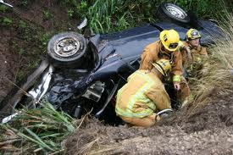
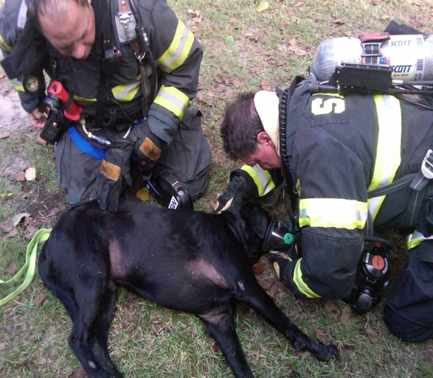
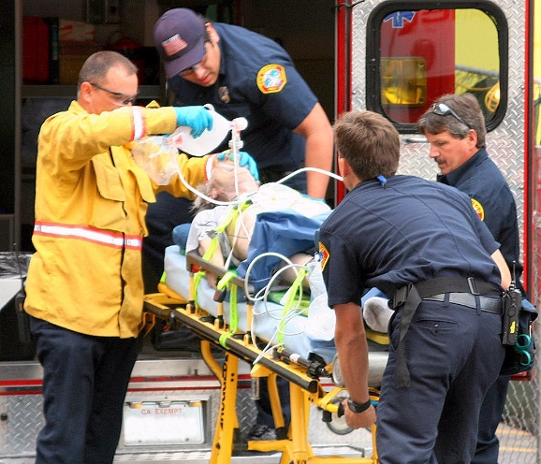
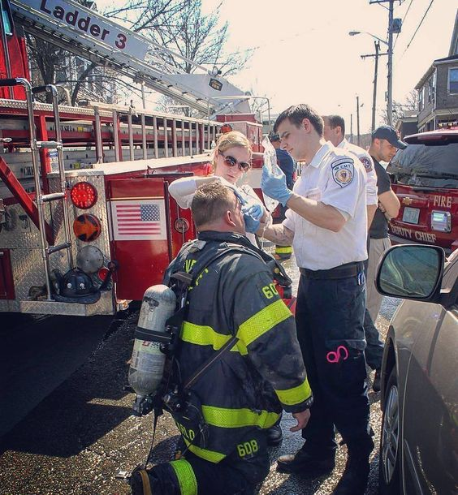
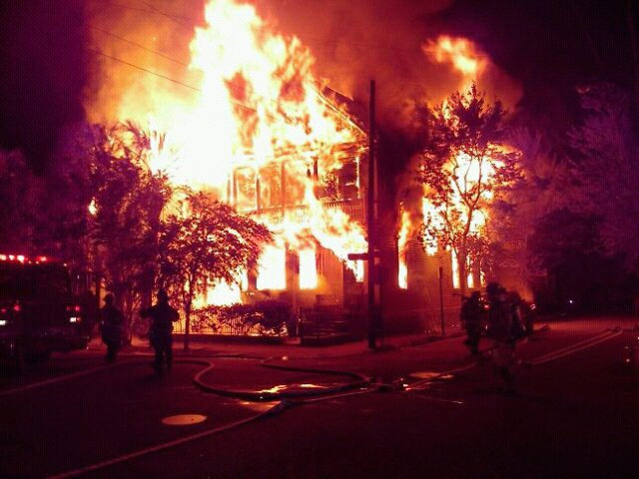
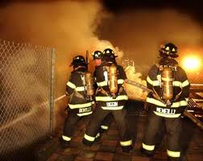
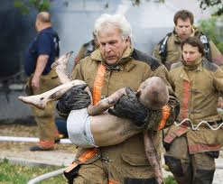
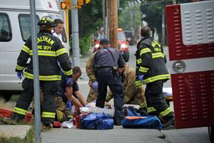
What’s in your
“File Folder”?
Notes:
27

Slide 28
Managing Your “File Folder”
Being aware of what might open your file
Have strategies available if file is opened
Provide yourself with opportunities to process these memories

Slide 29
So, What Can We Do?

Slide 30
Reaching Out..
To a Friend or Family Member
To a Peer Counselor
To a Pastor or a Chaplain
To a Mental Health Therapist

Slide 31
Resistance to Reaching Out
Afraid the word will get out
Others seem to be handling this by themselves and so “maybe I should too?”
The “Suck It Up” culture of the department discourages it.

Slide 32
Reaching out to a Friend/Family Member
Finding a Listener / Being a Listener;
Familiar with your situation;
Describe what you need from the conversation;
“Just being there”

Slide 33
Reaching Out to a Peer Counselor
Someone who can…
relate to what you are going through
understands your situation
You need to know…
what you tell them stays with them

Slide 34
“Often the most loving thing we can do when a friend is in pain is to share the pain-to be there even when we have nothing to offer except our presence and even when being there is painful to ourselves.”
M. Scott Peck

Slide 35
Reaching Out to Clergy or a Chaplain
Trusted individual
Familiar influence
Many organizations have strong chaplain programs
“Cultural comfort”

Slide 36
Reaching Out to a Mental Health Therapist
Opportunity to open up and process file folders
Receive reflection and guidance
Assistance in implementing effective coping techniques
Specific treatments for PTSD
Referral for medication if needed

Slide 38
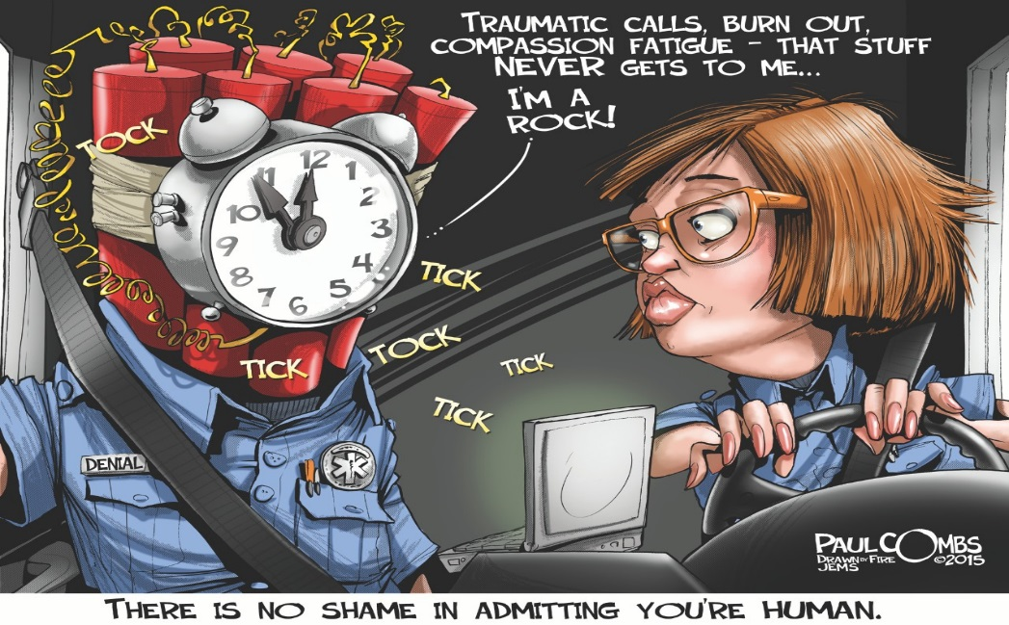

Slide 39
Taking Care of Each Other
Talking about incidents
Express concerns assertively
Offer to walk with individual through the process

Slide 40
REMEMBER!
Regardless of what role you are filing, don’t forget:
“People don’t want to be fixed, they want to be heard”

Slide 41
Proviso Policy
Why?
What?
When?
Who?
Where?
How?
Zorrina Harmon- Benefits Director
803-454-1802
zorrina@scfirefighters.org
Christan McConnell – Upstate DHEC Inspector/ Upstate FAST Coordinator
803-609-3645
864-357-1579
Christan.mcconnell@scfirefighters.org
mcconnca@dhec.sc.gov
psychomedicmom4@gmail.com
https://scfirefighters.org/FAST/

Slide 42
Helping Our Own A Program Dedicated to the Emotional Health and Well-Being of our First Responders and their Families
“Reaching Out”
Presented in Cooperation with the South Carolina State Firefighters’ Association, the South Carolina Fire Academy, the National Fallen Firefighters Foundation and the South Carolina Department of Mental Health.
First Responder’s Assistance & Support Team
F.A.S.T.
(800) 277-2732

